Slide 1


Intelligent Patent Management System with Automated Similarity Analysis
Punnoose Kozhuppakalam Thomas
Patent Gap AI

Slide 2
Problem Statement
Platform for Clients and Patent Attorneys to Match up
Similarity Analysis takes Months
Patents spread across multiple sources
No unified library across countries
similarity updates on newly filed patents are costly

Slide 3
Motivation
Manual Patent infringement detection is costly
Routine infringement detection is resource consuming
legal procedures require months of preparations
Keeping track of infringement cases can be confusing
Proper analysis can be challenging without right domain knowledge

Slide 4
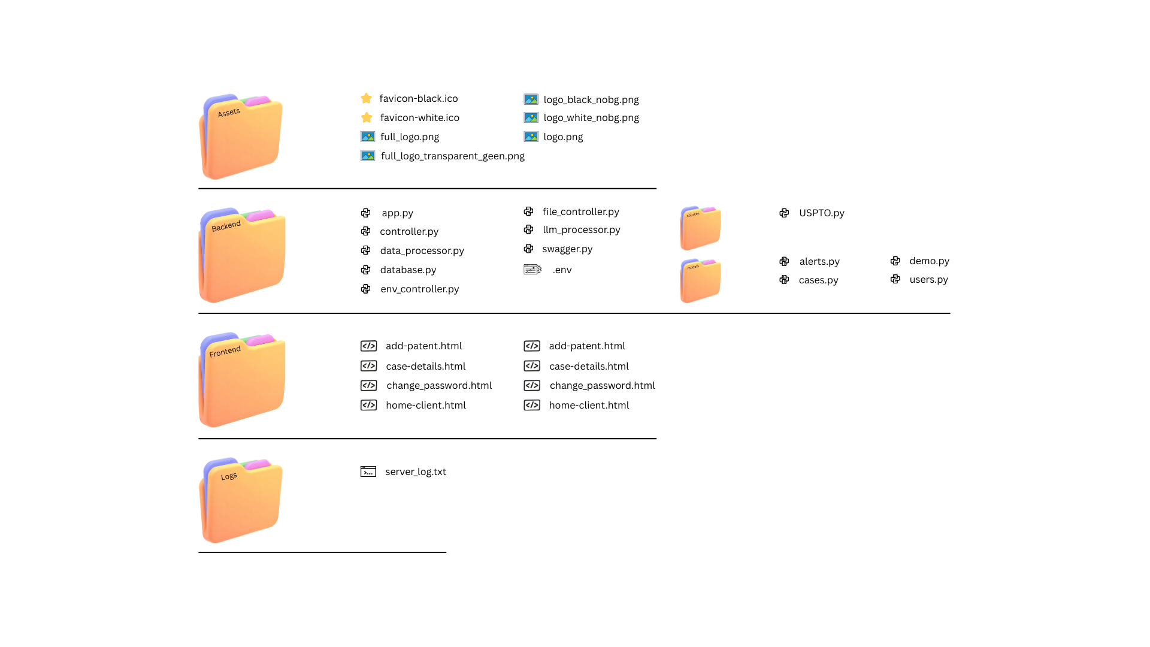
System Architecture

Slide 5
Core Features
Status Tracking system
Automated and Routine Similarity Analysis
Context based Similarity Analysis
Similarity Reports

Slide 6
Currently in Progress
Model Design (Embedding based Semantic Similarity)
Additional Data Mining from additional sources
Vector Storage in Database
Upgrading Similarity Check function
Generating Reports based on Claims
Notes:
EBSS Pipeline:
- Chunk patent documents (claims, abstract, description) -> completed. To be optimized
- Generate embeddings (e.g., sentence-level or claim-level) -> Completed. To be improved (TF:ID to Gpt)
- Store in a vector database -> In Progress
- Compare new patent embeddings against fetched patents -> completed
- Compute cosine similarity -> completed
- Filter results ≥ 80% -> completed
- Only then generate reports -> in progress
Why EBSS is Ideal:
- Deterministic similarity scores
- Scales well
- Easy to explain and audit (important for legal/IP)

Slide 7
Technologies Used
Frontend: HTML + CSS
Backend: Python Flask API
Database: Firebase (NoSQL)
Sources: US Patent Office Database
LLM Integrations: Gemini, OpenAI

Slide 8
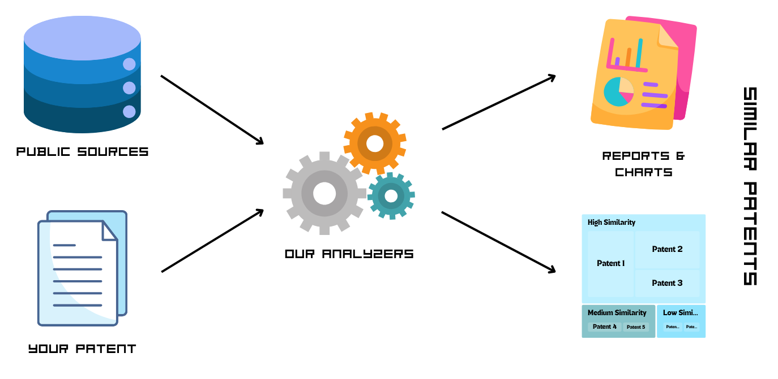
Flow chart

Slide 9
Future Enhancements
Switch to ReactJs for Frontend
Add interactive Chatbot for report exploration
Additional Sources
Advanced Security and Encryption

Slide 10
Thank You

